Slide 1
Topic 4.3 Where Data is Stored
C851 Cohort Live Session for Sunday, October 17, 2021
Dr. John S. Galliano | C851 Linux Foundations Instructor

Slide 2
Agenda
Welcome
Lecture
Demos
About the Exam
The 5 Exam Domains
Topic 4.3 Where Data is Stored
Wrap-Up

Slide 3

About the Linux Essentials v1.6 [1]
The 5 Exam Domains [3]
No prerequisites
Closed book, up to 60 minutes
40 multiple-choice (some multi-select and fill-in-the-blank items) questions
Min pass score 500 points (200-800 scale)
Partially correct responses not accepted (for F-I-T-B questions LPI may accept multiple correct versions of an answer [2]
Total exam weight count is 40, thus 40 questions
The Linux Community and a Career in Open Source
Finding Your Way on a Linux System
The Power of the Command Line
The Linux Operating System
Security and File Permissions
[1,3] Linux Professional Institute, “Linux Professional Institute Linux Essentials,” Linux Professional Institute, 21-Oct-2018. [Online]. Available: https://www.lpi.org/our-certifications/linux-essentials-overview. [Accessed: 14-Aug-2021]
[2] Dr. Galliano’s correspondence with LPI, dated August 2021: Example: with/without leading path in a case where the answer is a command
Notes:
Examples:
• If an objective has a weight of 3, there will be 3 questions on the exam related to that objective [2]
Links:
• View the 3rd party cert tips video at https://bit.ly/3party_cert_tips
• Dr. Galliano’s Github repo (study guide, cheatsheets, slidedecks, etc. at https://github.com/g33k247/851

Slide 4

LPI Exam Re-Take Policy [4]
Anyone who takes an LPI exam once must wait one week before re-taking
Anyone who takes an LPI exam a second (and subsequent) time must wait 30 days before re-taking
3rd and subsequent attempts at your own cost ($120)
[4] Linux Professional Institute, “Privacy Statement and Policies,” Linux Professional Institute, 18-May-2018. [Online]. Available: https://www.lpi.org/policies. [Accessed: 14-Aug-2021].
Notes:
• Anyone who passes an LPI exam may not retake that exam for two years

Slide 5

Exam Topics/Weightings
Linux Essentials v1.6 Exam Topics [5] | 1.1 | 2
 | 1.2 | 2
 | 1.3 | 1
 | 1.4 | 2
 | 2.1 | 3
 | 2.2 | 2
 | 2.3 | 2
 | 2.4 | 2
 | 3.1 | 2
 | 3.2 | 3
 | 3.3 | 4
 | 4.1 | 1
 | 4.2 | 2
 | 4.3 | 3
 | 4.4 | 2
 | 5.1 | 2
 | 5.2 | 2
 | 5.3 | 2
 | 5.4 | 1
 |  | 40
[5] Linux Professional Institute, “Linux Essentials Objectives V1.6 - LPI Wiki,” Linux Professional Institute, 25-Jan-2020. [Online]. Available: https://wiki.lpi.org/wiki/Linux_Essentials_Objectives_V1.6. [Accessed: 14-Aug-2021].
Notes:
• A weight of “1” equates to 1 exam question
• Since there is a weight of ‘3’, you will see 3 questions on this topic!

Slide 6

4.3 Where Data is Stored [6]
Weight: 3 (3 questions)
Description:
Where various types of information are stored on a Linux system
Key Knowledge Areas:
Programs and configuration
Processes
Memory addresses
System messaging
Logging
Files used, terms and utilities:
ps, top, free
syslog, dmesg
/etc/, /var/log/
/boot/, /proc/, /dev/, /sys/
[6] Linux Professional Institute (LPI), “Exam 010 Objectives,” Linux Professional Institute, 21-Oct-2018. [Online]. Available: https://www.lpi.org/our-certifications/exam-010-objectives. [Accessed: 10-Jul-2021].
Notes:
What to Know:
• Learning about your CPU
• Identifying motherboard capabilities
• Sizing your power supply
• Understanding disk issues
• Managing displays
• Handling USB devices
• Managing drivers
Commands (‘#’ denotes a comment):
• None
Links:
• https://explainshell.com/ to learn about commands, options, arguments
• https://github.com/g33k247/851 for Dr. Galliano’s GitHub repo of study resources

Slide 7
Programs and configuration
Binary files stored in /sbin, /bin, /usr/sbin, /usr/local/sbin
Configuration files stored in /etc and in /home (a.k.a., dotfiles)
.bash_history stores the command line history
.bash_logout commands executed when leaving the login shell
.bashrc Bash’s initialization script for non-login shells
.profile Bash’s initialization script for login shells
Kernels are stored in /boot
Psuedo filesystems: /dev, /proc, /sys
PRO TIP: You can find out what directories are available for you to run binaries from by referencing the PATH variable with echo $PATH. For more information on PATH, review the lessons on variables and shell customization.
Notes:
Commands (‘#’ denotes a comment):
man hier #info on the file hierarchy system (fhs)
# Where does Linux look for binaries?
echo $PATH #/home/$USER/bin
/home/$USER/.local/bin
# How can I find a binary?
which ls #find the location of programs
# Where does Linux store configuration information?
ls -la /etc |less #show contents of /etc
# Where are the Linux psuedo filesystems?
ls -la /boot #show boot files like compressed kernels
ls -la /dev
ls -la /proc
ls -la /sys
# Where does Linux store user configuration files?
cat .bash_history #stores the command line history
cat .bash_logout #includes commands to execute when leaving the login shell
cat .bashrc #bash initialization script for non-login shells
cat .profile #bash initialization script for login shells

Slide 8
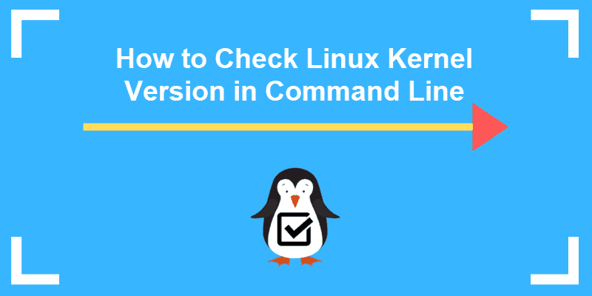
Find & Understand Your Kernel Version
Run uname –r, hostnamectl, cat /proc/version, dmesg |grep Linux
5.4.17-2102.201.3.el8uek.x86_64
5: main kernel version
.4: major release version (stable even, odd development)
.17: minor revision level
-2102.201.3: patch number and bug fixes
Architecture: x86_64
Notes:
Commands (‘#’ denotes a comment):
# What kernel is my system using?
uname –r, hostnamectl
cat /proc/version
dmesg |grep “Linux version”

Slide 9
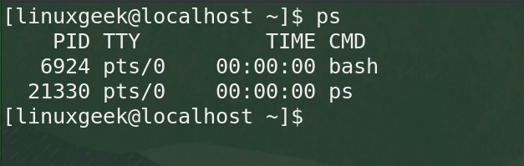
Processes
When a user issues a command, a program is run, and one or more processes are generated
Processes exist in a hierarchy
The ps command is snapshot of processes
Notes:
Commands (‘#’ denotes a comment):
ps -efH
pstree
ps -x #show only current user’s processes
ps -fU linuxgeek #or use UID like 1000
ps -fU 0 |grep -v root
# Show all processes running under root context:
sudo watch -n 0.1 -d 'ls -latr | tail -n 4'
ps -U root -u root #Note that watch run using sudo in previous command
# Custom ps commands
ps -eo pid,ppid,user,cmd #view the PID, PPID, username, and command of a process
ps -p 6924 -o pid,ppid,fgroup,ni,lstart,etime #show file system group, nice value, start time, and elapsed time
ps -eo comm,etime,user | grep sshd #check the execution time of a process
# System Monitoring
uptime #shows how long the system has been running
top #find top running processes by highest memory and CPU usage
ps -eo pid,ppid,cmd,%mem,%cpu --sort=-%mem | head #custom ps listing
sudo watch -n 0.1 -d 'ps -eo pid,ppid,cmd,%mem,%cpu --sort=-%mem | head'

Slide 10
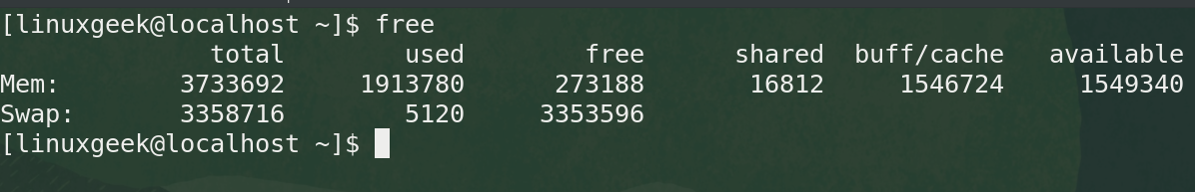
Memory addresses
2 Main types:
Physical memory, a.k.a. RAM
Swap, a.k.a. swap space or virtual memory
The free command parses /proc/meminfo to show free and used memory in the system:
Notes:
Commands (‘#’ denotes a comment):
free

Slide 11
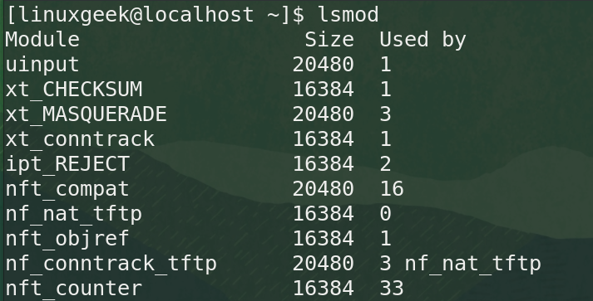
System messaging
Viewing drivers
Use the less /proc/modules and lsmod commands:
Notes:
Commands (‘#’ denotes a comment):
less /proc/modules #display kernel modules
lsmod #display kernel module with formatted output
modinfo driver-Name-Here modinfo thermal_sys modinfo e1000e
echo "Kernel drivers dir: \"/lib/modules/$(uname -r)/kernel/drivers/\" \ for Linux kernel version \"$(uname -r)\" “ #directory location of driver files
ls -l /lib/modules/$(uname -r)/kernel/drivers/ #view drivers
find /lib/modules/$(uname -r)/kernel/drivers/ -iname "driver-to-search-here“ #find a specific driver
lspci -v |tee filename.txt #use tee to display command to STDOUT and redirect to a filename
ls -ltr #check that filename was written
cat filename.txt #view the file
modinfo vmxnet3 #run modinfo on a specific driver

Slide 12
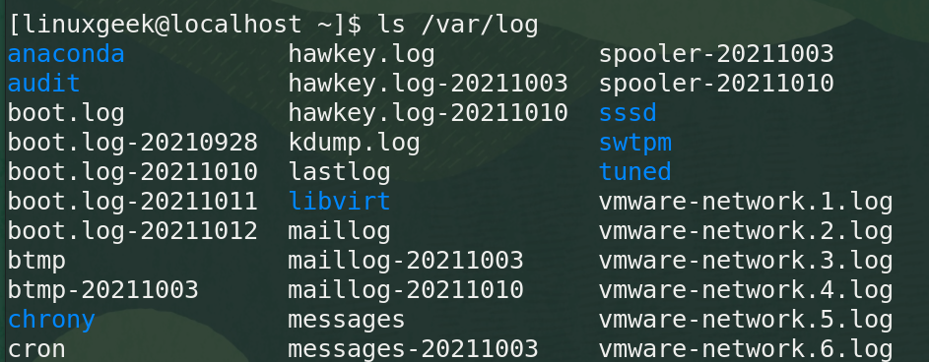
Logging
Log Files are data that varies over time and found in /var/log
/var/log/auth.log stores information about authentications
/var/log/kern.log stores kernel information
/var/log/syslog stores system information
/var/log/messages stores system and application data
Notes:
Commands (‘#’ denotes a comment):
ls /var/log
find . /var/log
# Tailing log files
tail -f /var/log/syslog -f /var/log/auth.log
sudo less +F /var/log/messages
ls -ltr #shows most recent files near bottom of display
touch newfile_{01..100}.txt #creates 100 files using brace expansion
ls -ltr | tail -n 3 #shows only the last 3 items
watch -n 0.1 -d 'ls -latr | tail -n 4’ #keeps track of the changes in the folder
# Using syslog
cat /etc/rsyslog.conf
sudo systemctl status rsyslog
ps -efH |grep -v grep |grep rsyslog

Slide 13
Common Linux log files and usage
Logfile + Location | Purpose
/var/log/messages | General message and system related stuff
/var/log/auth.log | Authentication logs
/var/log/kern.log | Kernel logs
/var/log/mail.log | Mail server logs
/var/log/httpd/ | Apache access and error logs directory
/var/log/boot.log | System boot log
/var/log/mysqld.log | MySQL database server log files
/var/log/utmp, /var/log/wtmp | Login records
/etc/rsyslog.conf | Syslog configuration file
PRO TIP: Use your Linux skills to monitor logs. A great way to get this done and see new log entries for all log sources is to use the find command: find /var/log/ -type f \( -name "*.log" \) -exec tail -f "$file" {} +;
Notes:
Commands (‘#’ denotes a comment):
find /var/log/ -type f \( -name "*.log" \) -exec tail -f "$file" {} +; #neat way to tail all your logs at once
ssh -t 192.168.1.99 "sudo tail -f /var/log/syslog" #remotely monitor a log over ssh

Slide 14

Demos
Based on Red Hat Enterprise Linux (RHEL)
Oracle Linux is an open-source clone
Did You Know? Oracle’s Linux distro is a clone of RHEL and used in the Oracle Cloud Infrastructure (OCI).
Notes:
Commands (‘#’ denotes a comment):

Slide 15

Notes:
Interested?
• Contact the email address or connect via social media links at the bottom of the graphic
• Mention that you were referred by Dr. Galliano.

Slide 16
What Questions Do you Have for Me?

